Slide 1


Networking, Interviewing, and Negotiating, Oh My!
Data Science Job Search #ProTips
T H I S I S M E T I S . C O M

Slide 2
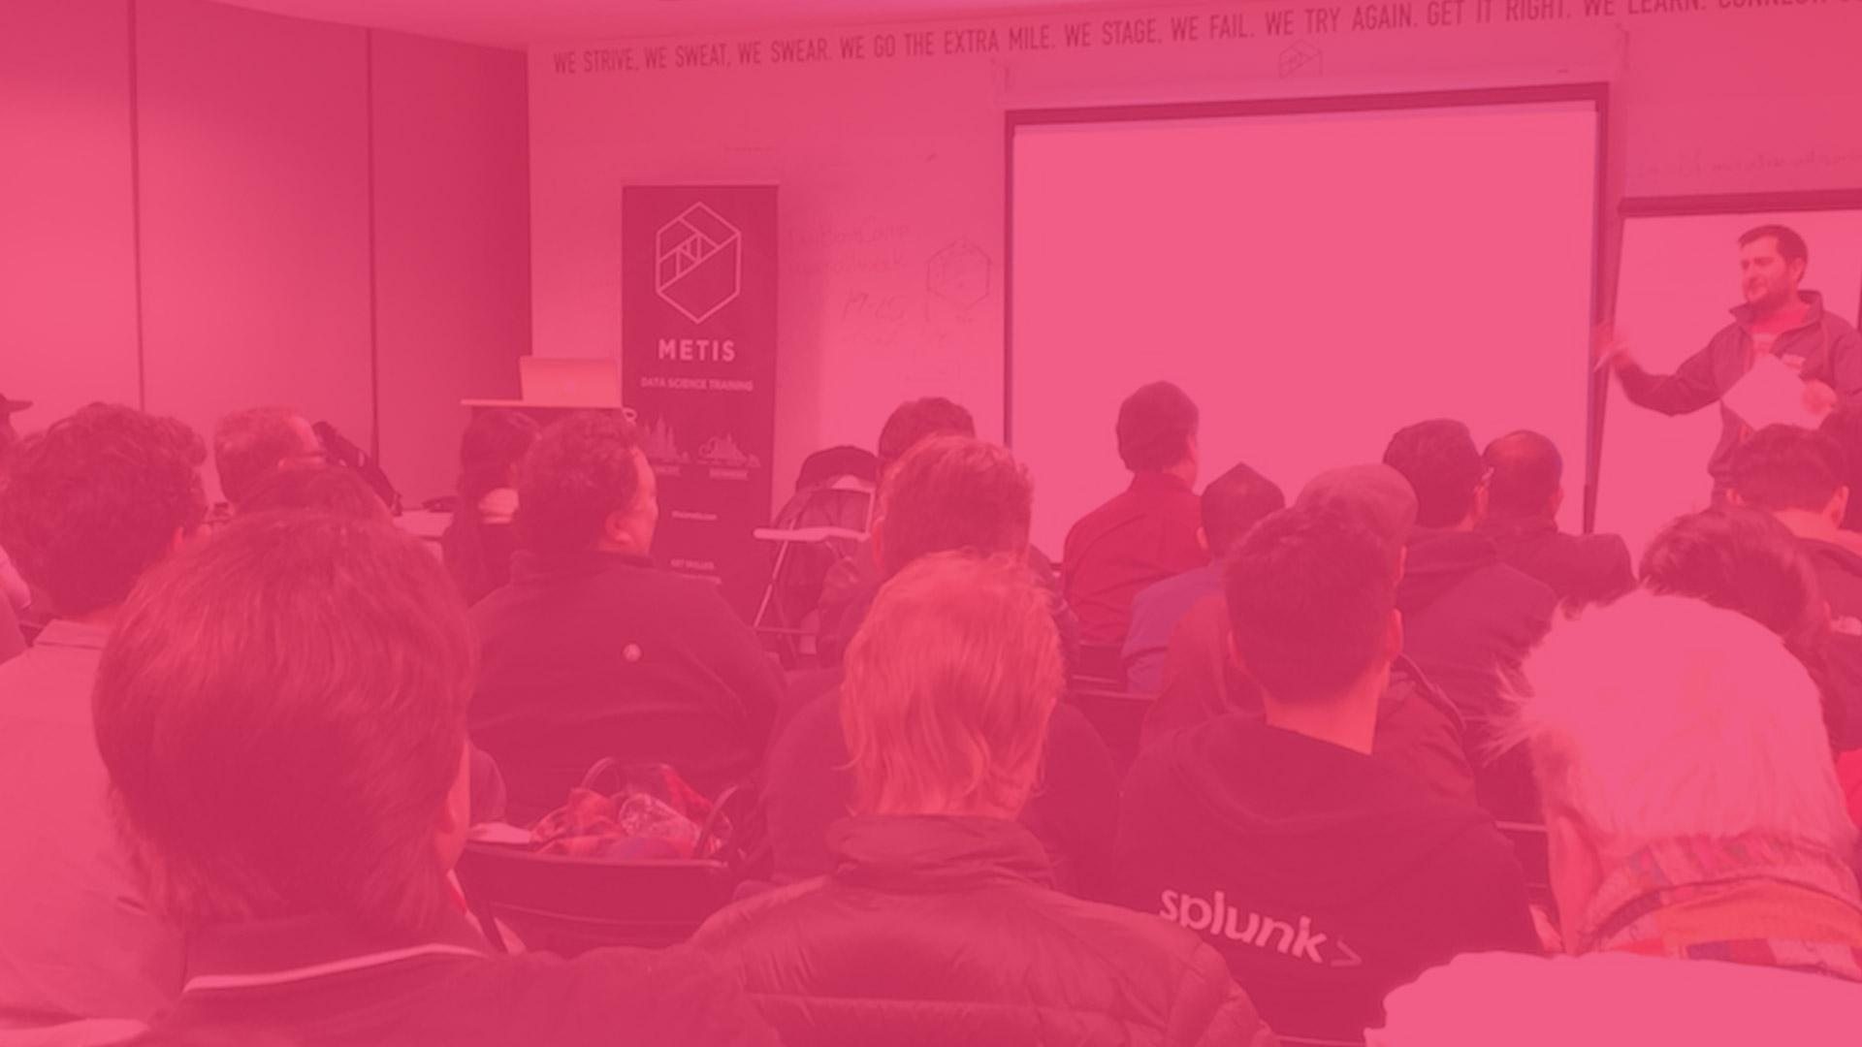

Data Science educator backed by Kaplan Test Prep
Provide customized corporate training for clients
WHAT IS METIS?
Part-time Professional Development and Live Online Courses
Full-time immersive bootcamp

Slide 3
WHAT DO I DO AT METIS?
Coach and advise students and graduates
Employer relations
ADMISSIONS PROCESS

Slide 4
TO FIND A JOB YOU NEED A P.L.A.N.
PRACTICE
LEARN
APPLY
NETWORK
ADMISSIONS PROCESS

Slide 5
TONIGHT’S AGENDA
Basics of Networking
Interview Prep & Expectations
Basics of Negotiating

Slide 6
APPLY +

Slide 7
APPLY
LOOK FOR SOMEONE YOU KNOW
IF YOU HAVE TO APPLY COLD, FOLLOW UP

Slide 8

NETWORKING
WHO LIKES MEETING INDIVIDUALS WITH SIMILAR INTERSTS AND TALKING ABOUT COOL STUFF?

Slide 9
NETWORKING
70% of jobs are found through networking
Nearly 50% jobs are unadvertised
21% found best job through social networking

Slide 10
NETWORKING STRATEGY
Find meetups & events that look interesting
Meetup.com: Metis: Chicago Data Science
Eventbrite
Twitter/Facebook
Google
Go to at least 2 events per week
Strike up conversations with at least 5 people at each event
Connect to speakers/hosts
Connect on LinkedIn & create follow up

Slide 11
NETWORKING STRATEGY
Ask open ended questions
Practice active listening
Share your story
Share your goals
Add value when you can

Slide 12
REMEMBER...
Data Scientists are normal people
You are every bit the same caliber “talent” as they are (they have just spent more time doing it)
Not everyone will be helpful or nice, but the ones that are can help big time

Slide 13



INTERVIEWING

Slide 14
INTERVIEW PREP
Understand fundamentals of their business
How they make their money
Who are their customers
Who is their competition or who are they displacing
How is data science integral to their success
Know the company’s mission
Research the background of the founders/key staff
Research company news/recent developments

Slide 15
INTERVIEW PREP
Start to think about…
What tools and languages are most important
The nature of the data
How you would operate in this role
What the team structure and dynamic is like
The future of the team/company
What are some of their problems or challenges and how can you solve them

Slide 16
INTERVIEW PREP
Questions you might be asked...
About your background (prepare your narrative!)
How you might fit into their culture (interests/personality based questions)
Your strengths and weaknesses
Possibly brain teasers or how you might optimize the product
Salary expectations

Slide 17
INTERVIEW PREP
YOU
COMPANY
Interests
Skills
Education
Work Experience
Projects
Goals
Team’s goals
Company’s mission
Their data processes
Their client or stakeholders
YOUR VALUE

Slide 18
TECHNICAL INTERVIEWS
Talk through your solutions because an employer wants to gauge...
Your thought process
How you approach a problem
If you can think fast on your feet
Do you ask for help or ask clarifying questions

Slide 19
TECHNICAL INTERVIEWS
If asked a question outside of your domain...
Do This:
Not This:
Be Honest about what you don’t know
Ask follow-up questions/ Talk it through
Relate it to something similar
Answer without a clue of the answer or how to solve the problem
Give up too quickly

Slide 20
TECHNICAL INTERVIEWS
BE CODE COGNIZANT!
Is this code reusable?
Is this code intuitive?
Are you just coding to get it done?

Slide 21
TECHNICAL INTERVIEWS
LISTEN FIRST, ANSWER SECOND!
Use active listening so you understand the question asked
Take a beat, don’t just jump right in
Understand what kind of technical problem it is. There are two types:
Coding. The interviewer wants to see you write clean, efficient code
Chitchat. The interviewer wants to talk about something

Slide 22
TECHNICAL INTERVIEWS
^{WHEN IN DOUBT, DRAW IT OUT}

Slide 23
THE JOB OFFER!

Slide 24
I GOT THE OFFER… NOW WHAT?
Before you negotiate your salary, know what you want:
What’s important? (Base salary, educational reimbursement, vacation, etc.)
What are your numbers? (Top? Middle? Bottom?)
How does this role or company position you for the future? (Skills, tools, titles you want long term.)

Slide 25
I GOT THE OFFER… NOW WHAT?
Do your research:
Glassdoor or similar sites
Friends, contacts, recruiters
Remember offers are based on a number of different factors:
You
Job duties/responsibilities
The team
Company size/budget
Type of company/industry

Slide 26
THE ART OF NEGOTIATING
Resist rushing an offer
Be humble
Don’t be too brash BUT don’t be too timid
NEVER LIE
Resist accepting the first offer if it’s not the right one
Remember you can negotiate on things other than salary:
Education reimbursement
Vacation
Salary review
Later start date
Be creative!

Slide 27
REMEMBER...
STAY POSITIVE, YOU GOT THIS!

Slide 28




THANK YOU!
linkedin.com/in/ashleypurdy
twitter.com/ashispurdy
thisismetis.com

